Slide 1
Python
Part 2

Slide 2
Data Frames
A data frame is a two-dimensional tabular labeled data structure with columns of potentially different types.
A data frame can be created from numerous data collections such as the following:
- A 1D ndarray, list, dict, or series
- 2D Numpy ndarray
- Structured or record ndarray
- A series
- Another data frame
A data frame has arguments, which are an index (row labels) and columns (column labels)

Slide 3
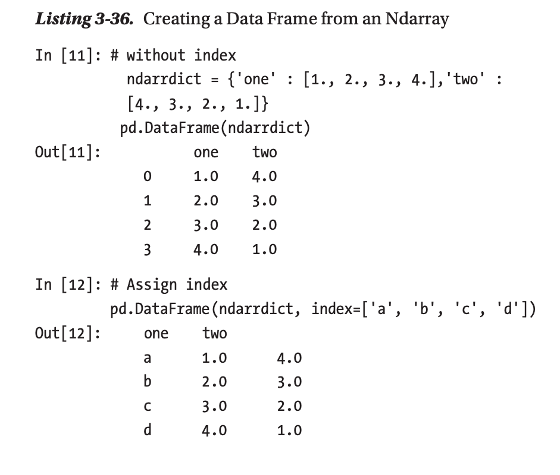
Data Frames-Creating Data Frame from Ndarray

Slide 4
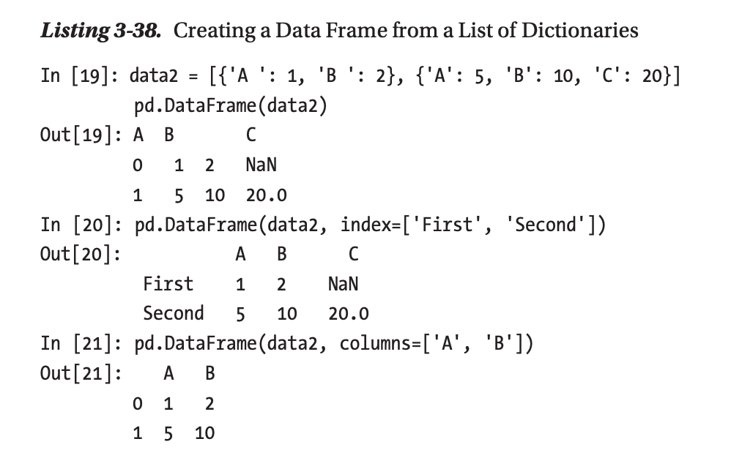
Creating Data Frames from a List of Dicts

Slide 5
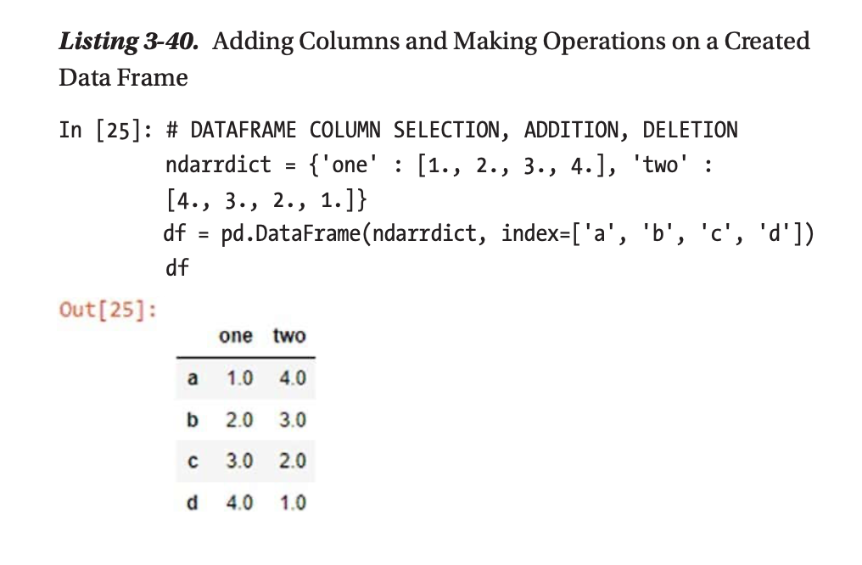
Adding Data Frame Columns

Slide 6
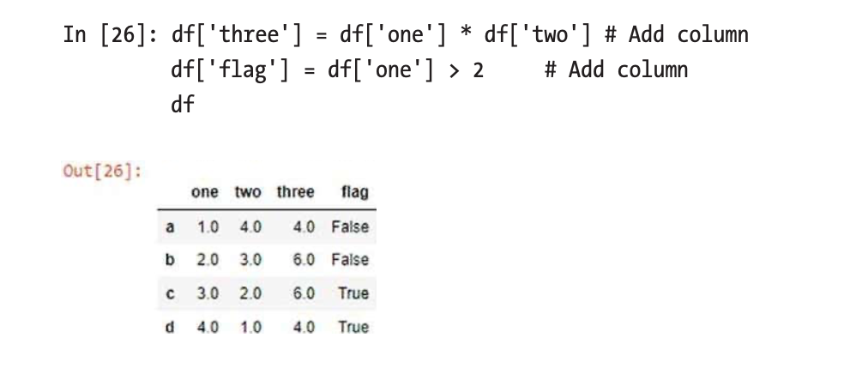

Slide 7
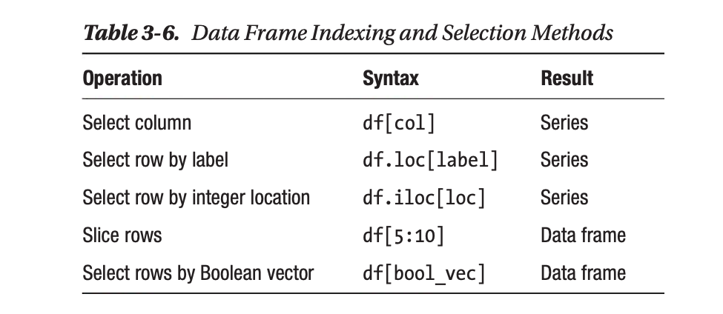
Indexing and Selecting Data Frames

Slide 8
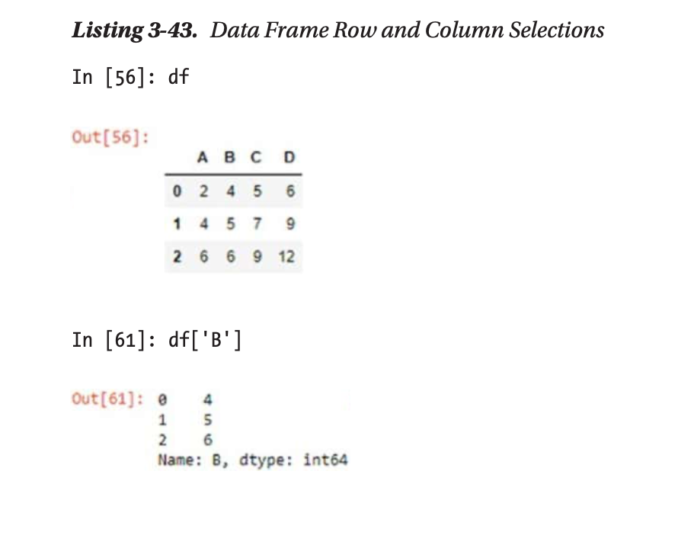

Slide 9
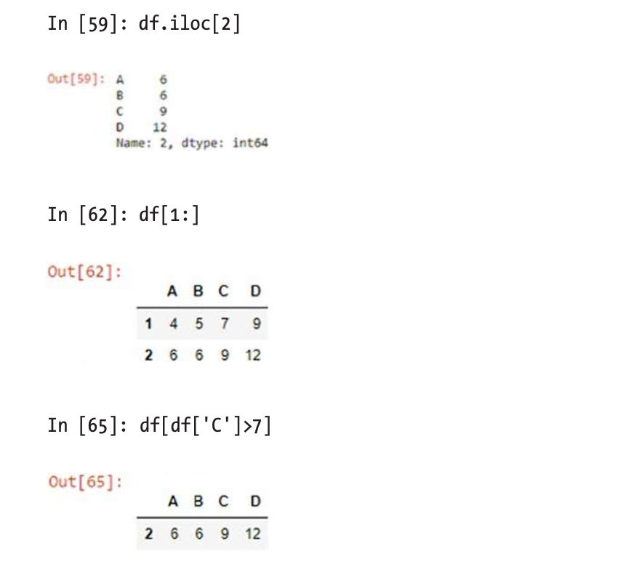

Slide 10
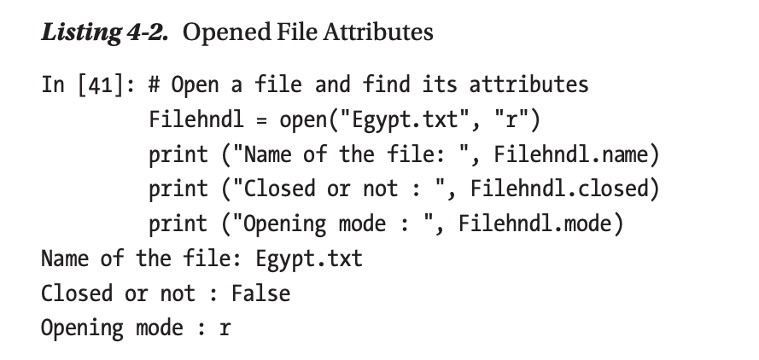
Open File
You can open a file using Open() method.

Slide 11
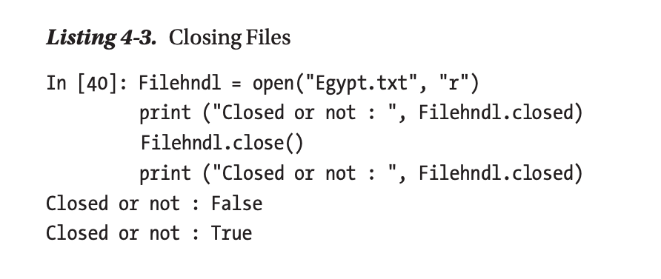
Closing Opened File
You can close an opened file using the close() method to clear all related content from memory and to close any opened streams to the back-end file, as shown in Listing 4-3.

Slide 12
Reading and Writing to Files
The file.write() method is used to write to a file, and the file.read() method is used to read data from an opened file.
A file can be opened for writing (W), reading (r), or both (r+), as shown in Listing 4-4.

Slide 13
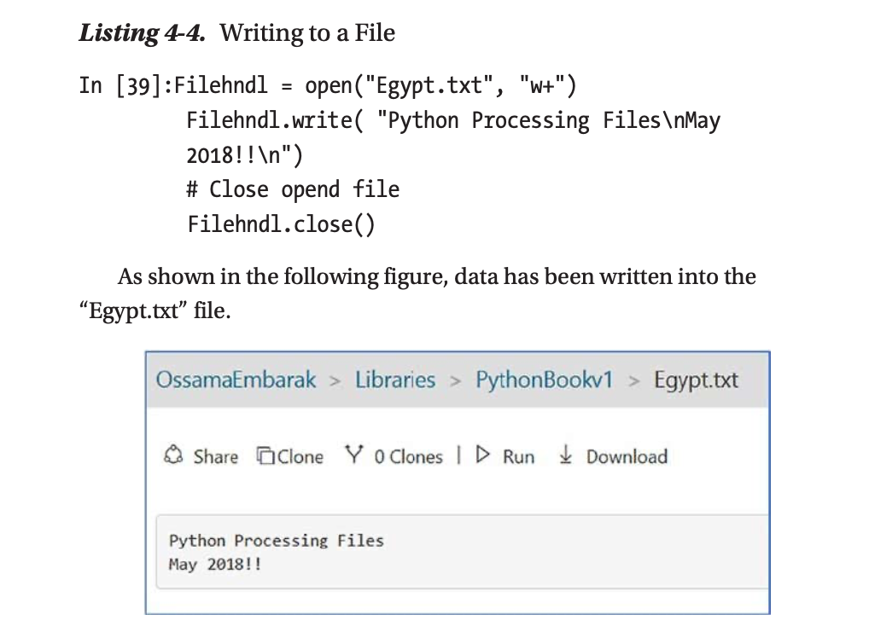
Writing to a File

Slide 14
Rename and Remove a File
The rename() method is used to rename a file; it takes two arguments: the current filename and the new filename. Also, the remove() method can be used to delete files by supplying the name of the file to be deleted as an argument.
Example:
In [34]: import os
os.rename( "Egypt.txt", "test2.txt" )
os.remove( "test2.txt" )

Slide 15
Reading and Processing a Text file
if you have a text file of e-mail log data and you want to extract only the text lines where the @uct.ac.za pattern appears, then you can use iteration to capture only the lines with the given pattern, as shown in Listing 4-6.

Slide 16
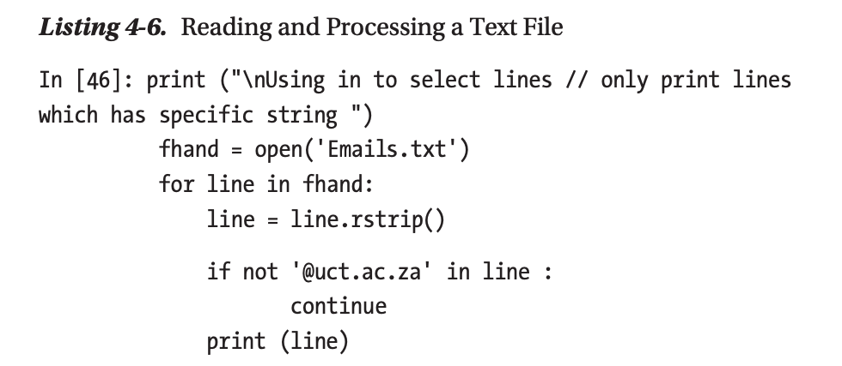

Slide 17
You can extract only the lines starting with From:. Once it has been extracted, then you can split each line into a list and slice only the e-mail element, as indicated in Listing 4-7 and Listing 4-8.

Slide 18
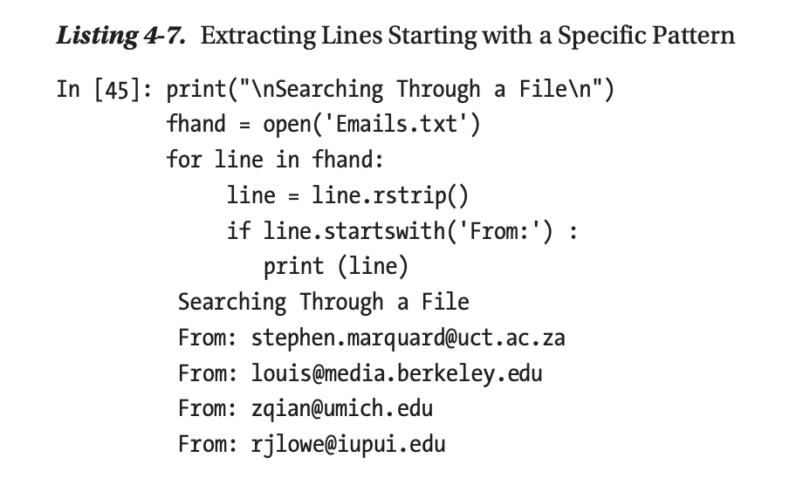

Slide 19
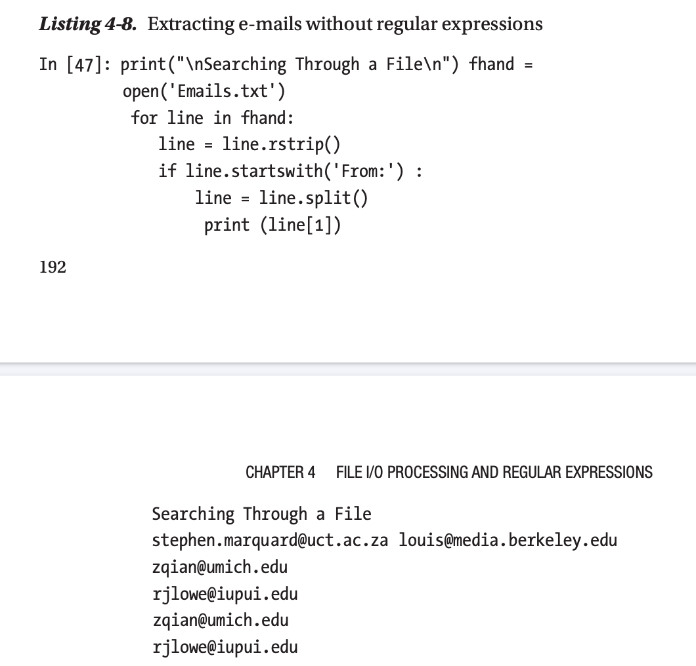

Slide 20
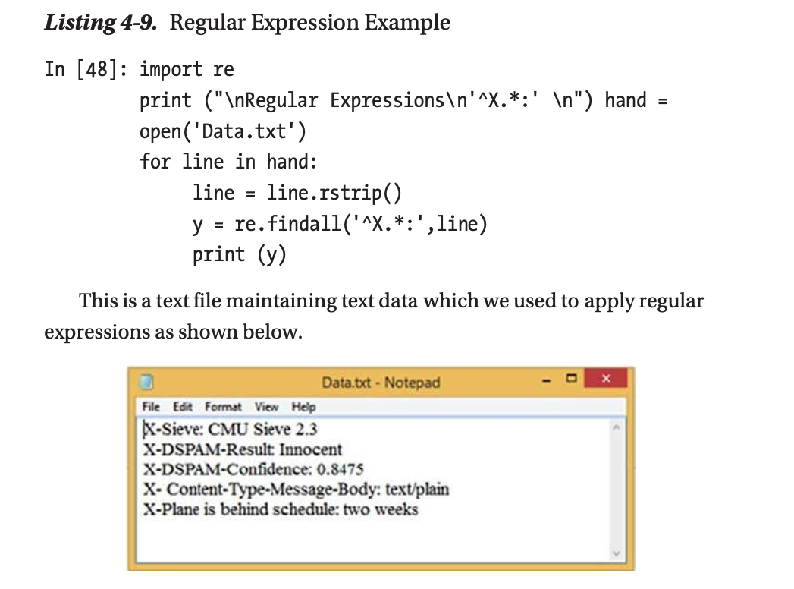

Slide 21
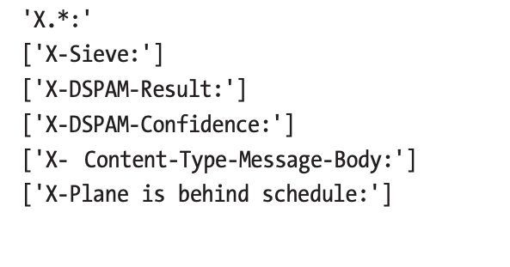

Slide 22
Data Gathering and Cleaning
In the 21st century, data is vital for decision-making and developing long- term strategic plans. Python provides numerous libraries and built-in features that make it easy to support data analysis and processing. Making business decisions, forecasting weather, studying protein structures in biology, and designing a marketing campaign are all examples that require collecting data and then cleaning, processing, and visualizing it.
There are five main steps for data science processing.

Slide 23
Data Gathering and Cleaning
1- Data acquisition: is where you read data from various sources of unstructured data, semistructured data, or full-structured data that might be stored in a spreadsheet, comma-separated file, web page, database, etc.
2- Data cleaning: is where you remove noisy data and make operations needed to keep only the relevant data.
3- Exploratory analysis: is where you look at your cleaned data and make statistical processing ﬁts for speciﬁc analysis purposes

Slide 24
Data Gathering and Cleaning
4- An analysis model needs to be created. Advanced tools such as machine learning algorithms can be used in this step.
5- Data visualization: is where the results are plotted using various systems provided by Python to help in the decision-making process.

Slide 25
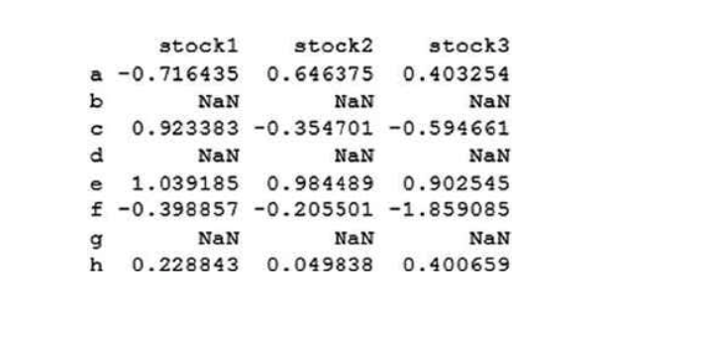
Cleaning Data-Example

Slide 26
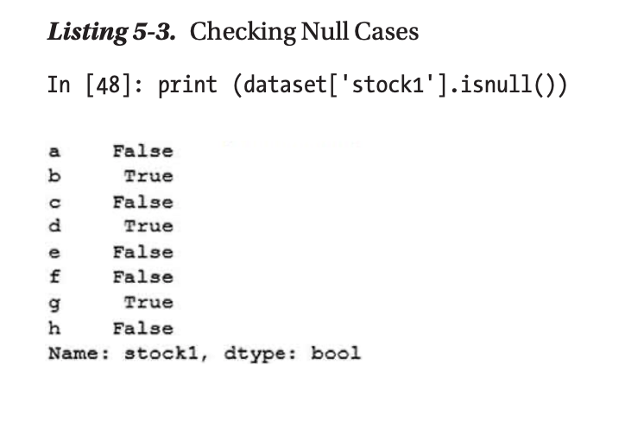
Cleaning Data-Example

Slide 27
Handling the Missing Values
You can replace NaN with a scalar value.
Listing 5-4 replaces all NaN cases with 0 values.

Slide 28
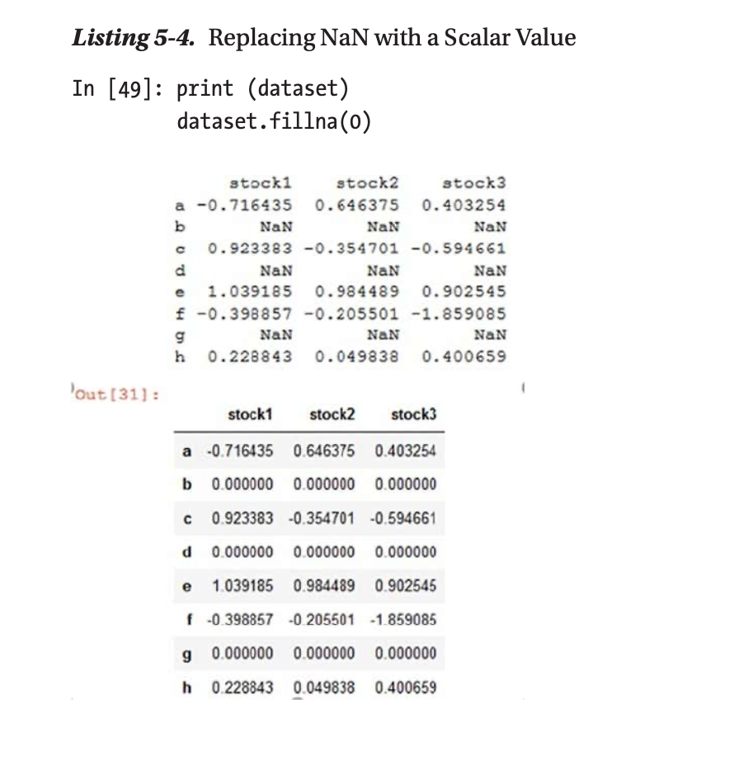

Slide 29
Handling the Missing Values
Another technique is to exclude all the rows with NaN values. The Pandas dropna() function can be used to drop entire rows from the data set. As you can see in Listing 5-6, rows b, d, and g are removed entirely from the data set.

Slide 30
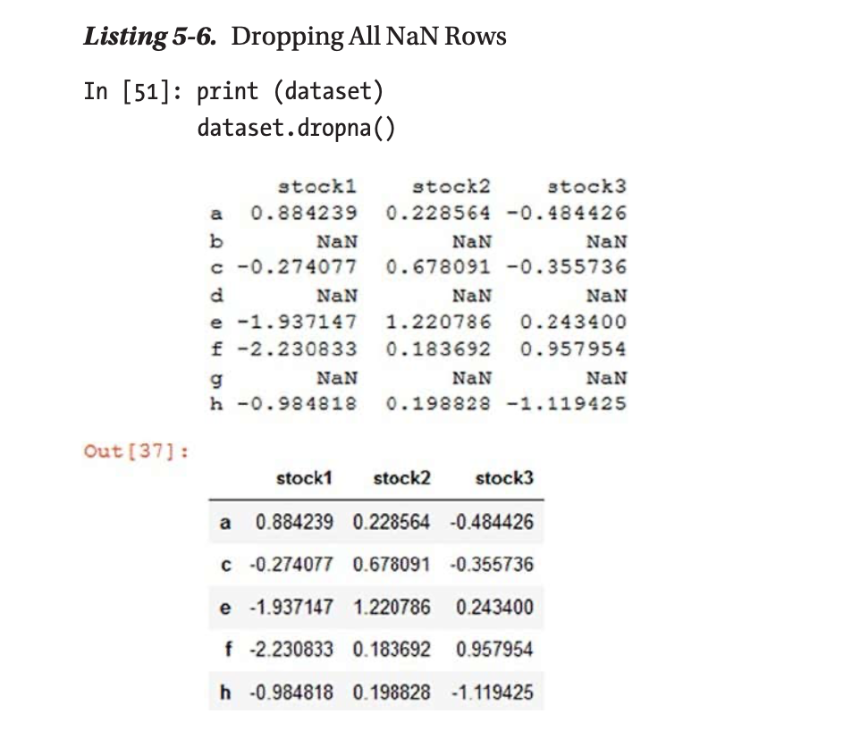

Slide 31
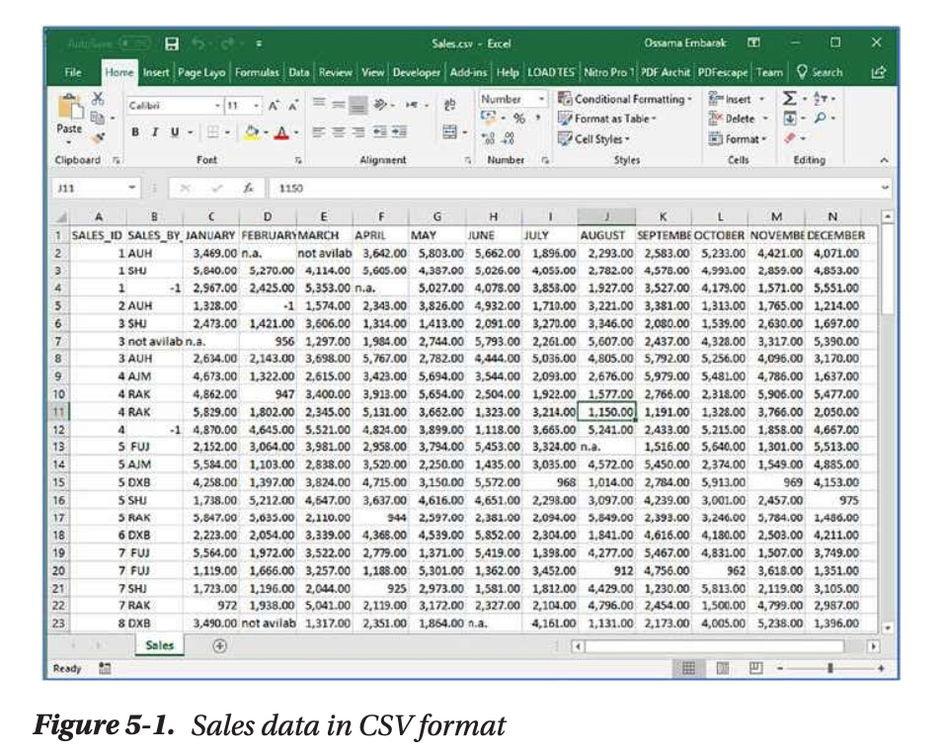
Reading and Cleaning CSV Data
You can read data from a comma-separated values (CSV) file.

Slide 32
Reading CSV File
You can use the Pandas library to read a file and display the first five records. An autogenerated index has been generated by Python starting with 0, as shown in Listing 5-8.

Slide 33
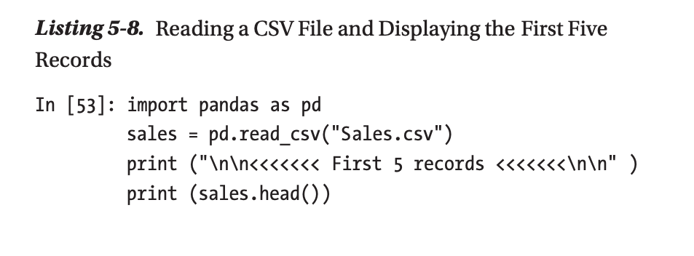
Reading CSV File-Example

Slide 34
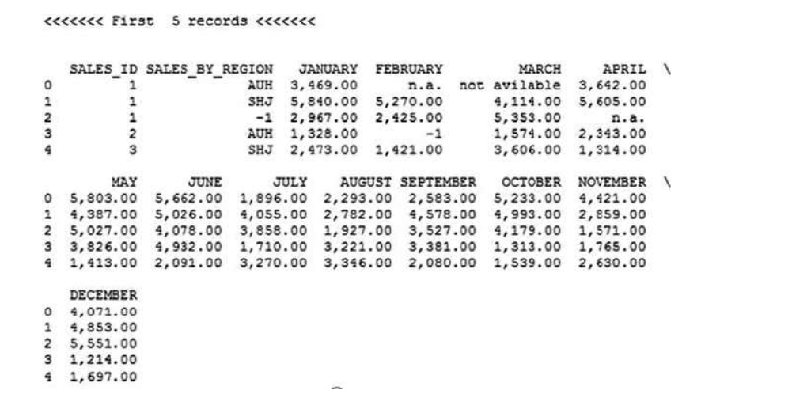

Slide 35
Reading CSV File
You can display the last five records using the tail() method.
In [54]: print (sales.tail())
pd.read_csv() is used to read the entire CSV file.
Sometimes you need to read only a few records to reduce memory usage, though. In that case, you can use the nrows attribute to control the number of rows you want to read.
In [55]: import pandas as pd
salesNrows = pd.read_csv("Sales.csv", nrows=4)
salesNrow

Slide 36
Reading CSV File
Similarly, you can read specific columns using a column index or label. Listing 5-9 reads columns 0, 1, and 6 using the usecols attribute and then uses the column labels instead of the column indices.
In [58]: salesNrows = pd.read_csv("Sales.csv", nrows=4, usecols=[0,
1, 6])
salesNrows

Slide 37
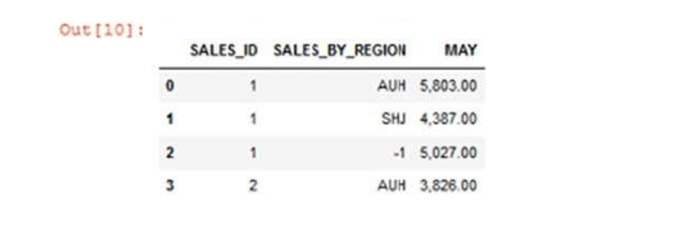

Slide 38
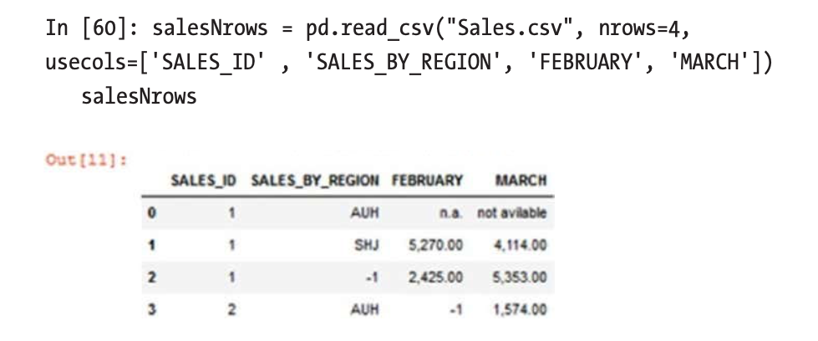
Example

Slide 39
Renaming Column Lables
In Listing 5-10, the .rename() method is used to change data set column labels (e.g., SALES_ID changed to ID). In addition, you set inplace=True to commit these changes to the original data set, not to a copy of it.

Slide 40
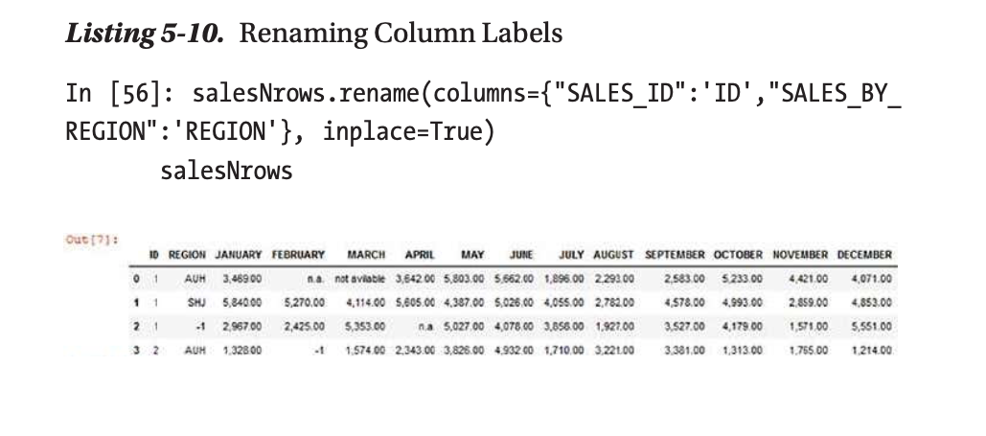
Renaming Column Lables-Example

Slide 41
Reading Data from the HTML Format
You can read online HTML files, but you should install and use the Beautiful Soup package to do so. Listing 5-23 shows how to make a request to a URL to be loaded into the Python environment. Then you use the HTML parser parameter to read the entire HTML file. You can also extract values stored with HTML tags.

Slide 42
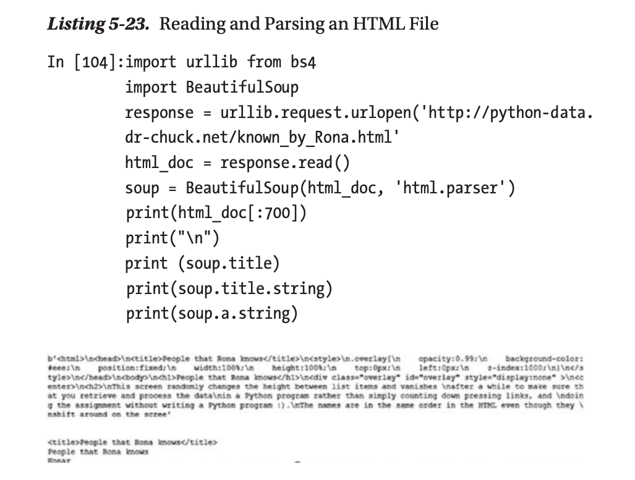

Slide 43
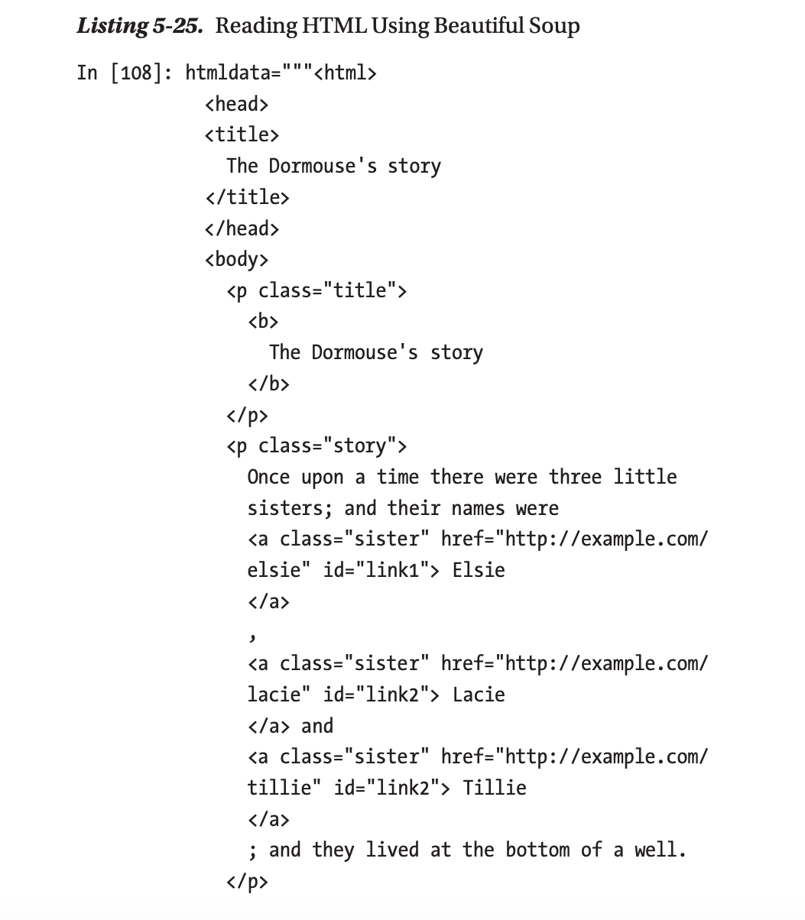

Slide 44
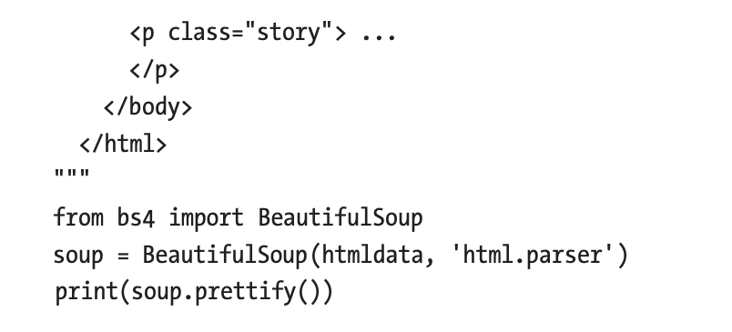
Continue

Slide 45
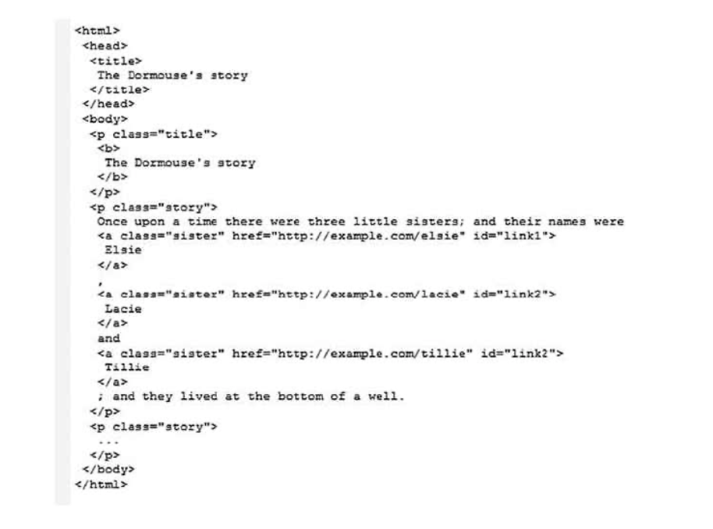

Slide 46
Reading Data from the HTML Format
You can also use Beautiful Soup to extract data from HTML. You can extract data, tags, or all related data such as all hyperlinks in the parsed HTML content, as shown in Listing 5-26.

Slide 47
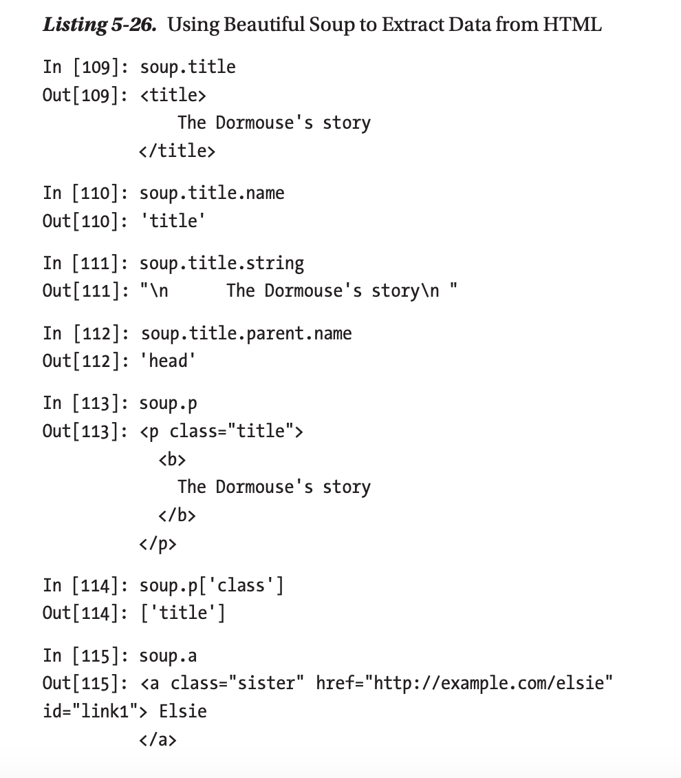
Example

Slide 48
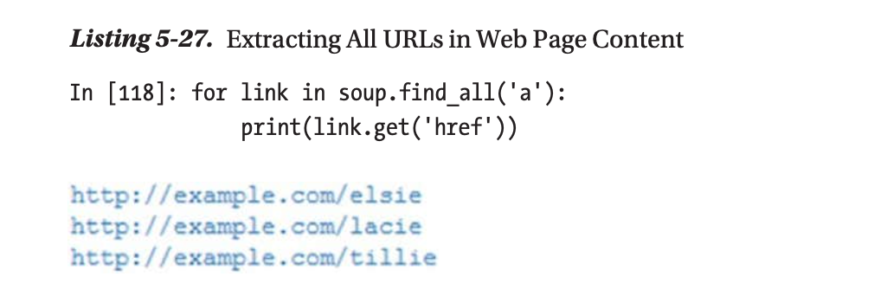
Extracting URLs in a Web Page Content

Slide 49
Extracting only the Contents of a Web Page
Listing 5-28. Extracting Only the Contents
In [119]: print(soup.get_text()

Slide 50
Data Visualization
Python provides numerous methods for data visualization.
Various Python libraries can be used for data visualization, such as Pandas, Seaborn, Bokeh, Pygal, and Ploty.
Python Pandas is the simplest method for basic plotting.
Python Seaborn is great for creating visually appealing statistical charts that include color.
Python Bokeh works great for more complicated visualizations, especially for web-based interactive presentations.
Python Pygal works well for generating vector and interactive files. However, it does not have the flexibility that other methods do.
Python Plotly is the most useful and easiest option for creating highly interactive web-based visualizations.

Slide 51
Data Visualization
Bar charts are an essential visualization tool used to compare values in a variety of categories. A bar chart can be vertically or horizontally oriented by adjusting the x- and y-axes, depending on what kind of information or categories the chart needs to present.

Slide 52
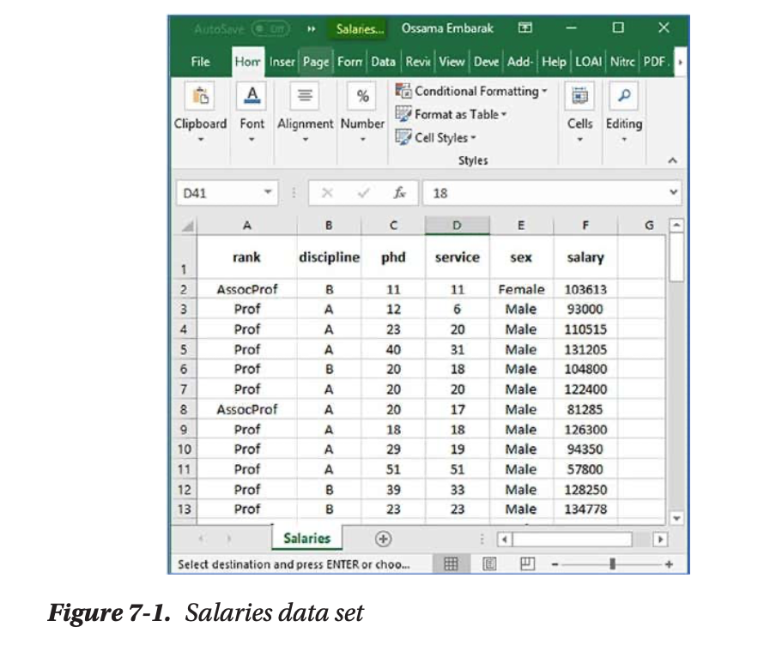
Data Visualization
salaries.csv file

Slide 53
Direct Plotting
Pandas is a Python library with data frame features that supplies built-in options for plotting visualizations in a two-dimensional tabular style.
In Listing 7-1, you read the Salaries data set and create some vectors of variables, which are rank, discipline, phd, service, sex, and salary

Slide 54
Direct Plotting: Example
Listing 7-1. Reading the Data Set
In [3]: import pandas as pd
dataset = pd.read_csv("./Data/Salaries.csv")
rank = dataset['rank’]
discipline = dataset['discipline’]
phd = dataset['phd’]
service = dataset['service’]
sex = dataset['sex’]
salary = dataset['salary'] dataset.head()

Slide 55
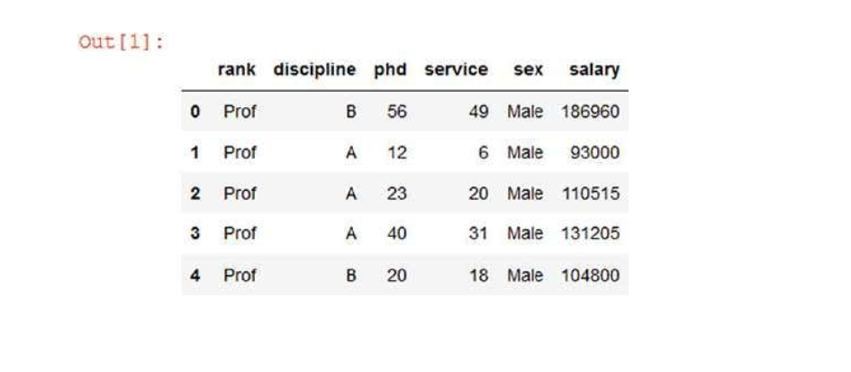

Slide 56
Listing 7-2. Visualizing Patterns with High Differences in Numerical Units
In [5]: dataset[["rank", "discipline","phd","service",
"sex", "salary"]].plot()

Slide 57
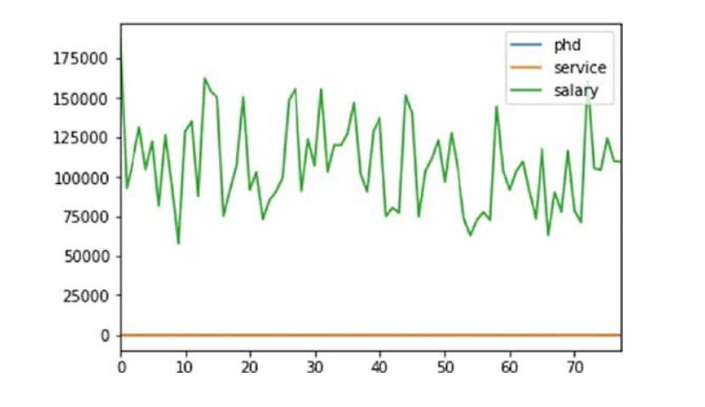

Slide 58
Bar Plot
Listing 7-5 shows how to plot the first ten records of phd and services , and you can add a title as well.
To add a title to the chart, you need to use .bar(title="Your title")
Listing 7-5. Bar Plotting
In [9]: dataset[[ 'phd', 'service' ]].head(10).plot.bar()

Slide 59
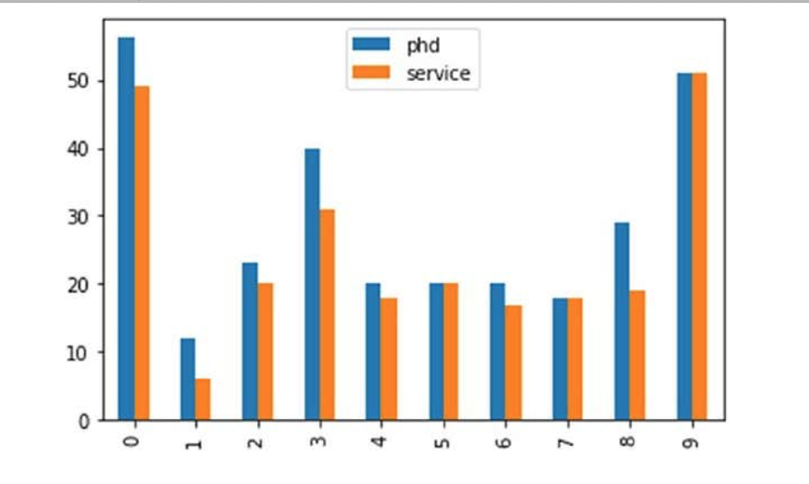

Slide 60
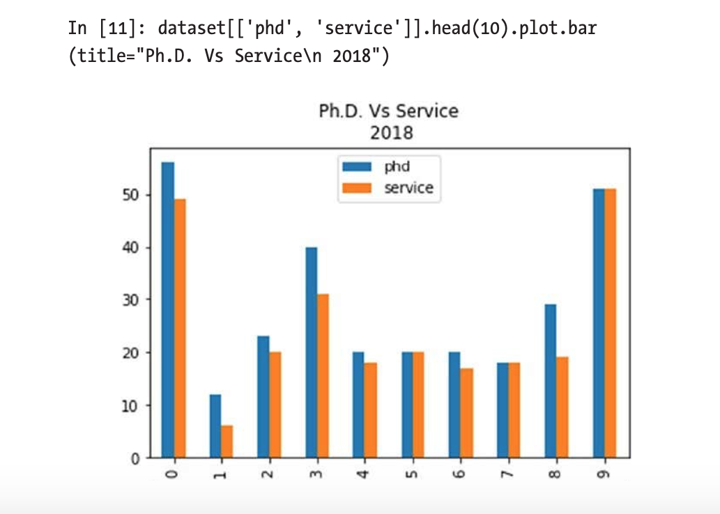
Example

Slide 61
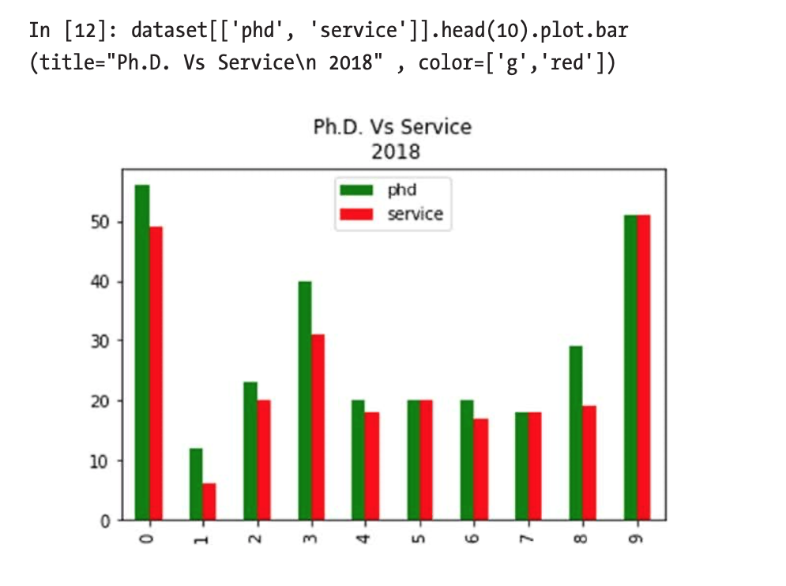

Slide 62
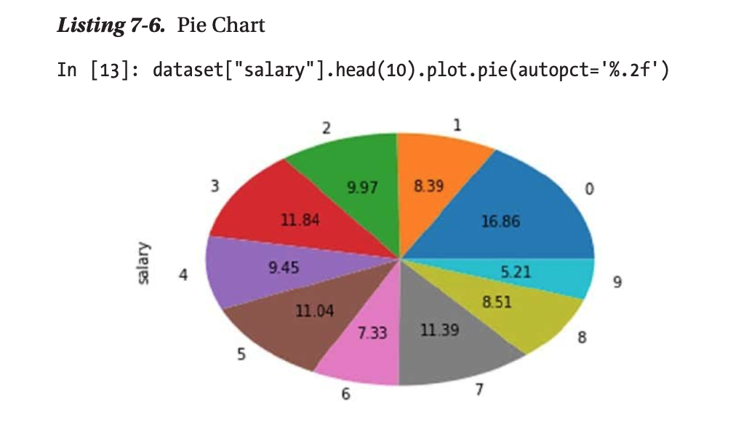
Pie Chart

Slide 63
Bar Chart
Listing 7-17 shows how to create a bar chart to present students registered for courses; there are two students who are registered for four courses.
Listing 7-17. Matplotlib Bar Chart Plotting
In [3]: Students = [2,4,6,8,10]
Courses = [4,5,3,2,1]
plt.bar(Students,Courses, label="Students/Courses")
plt.xlabel('Students ') plt.ylabel('Courses’)
plt.title('Students Courses Data\n 2018’)
plt.legend()
plt.show()

Slide 64
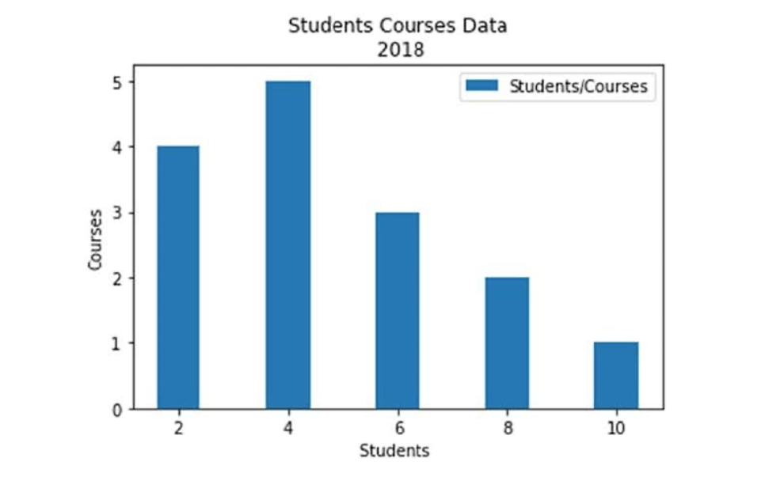

Slide 65
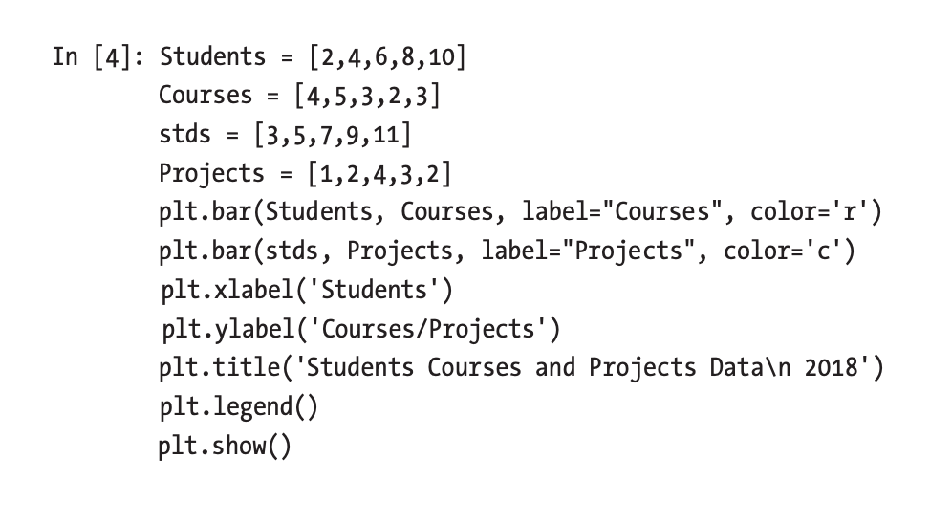
Bar Chart-Example

Slide 66
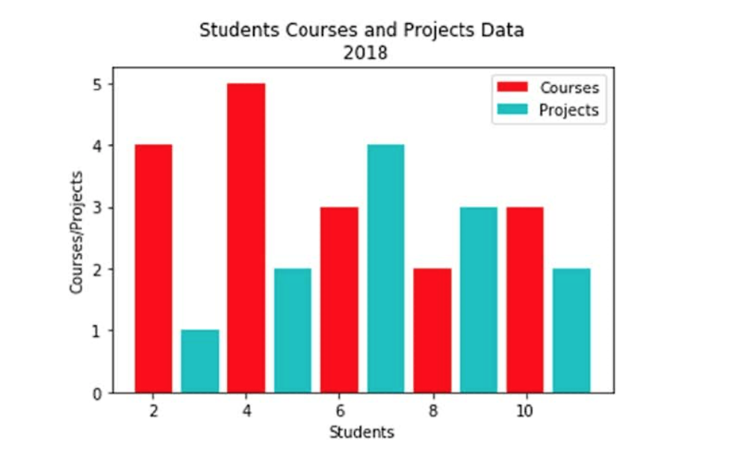

Slide 67
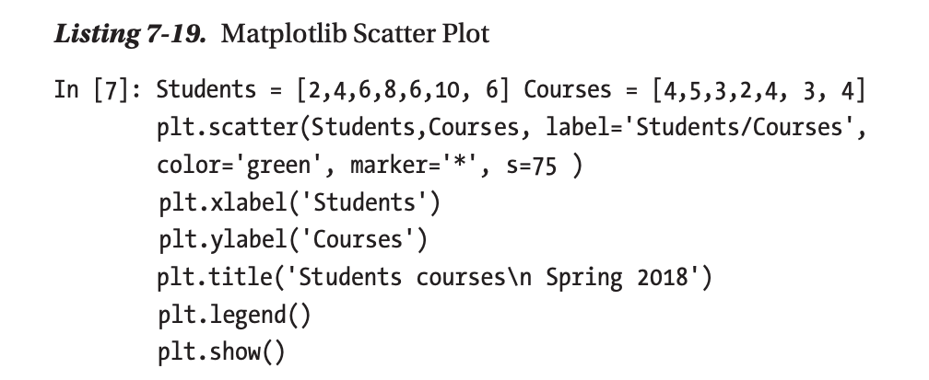
Scatter Plot-Example

Slide 68
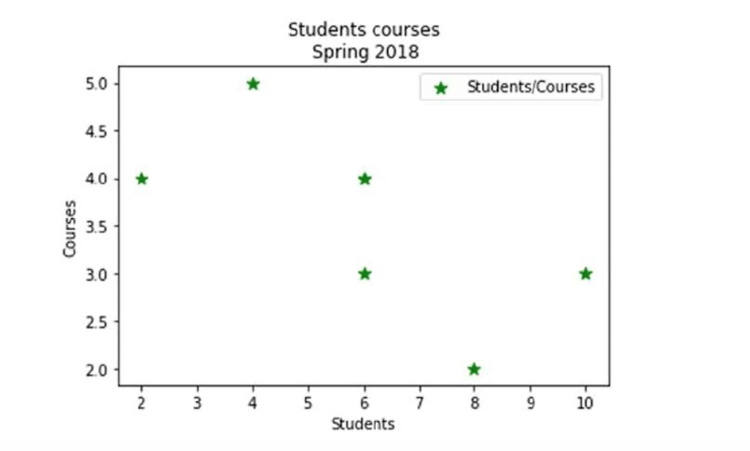

Slide 69
References
Data Analysis and Visualization Using Python, Dr. Ossama Embarak, ISBN-13 (electronic): 978-1-4842-4109-7, Copy right 2018.

